Slide 1
Physics-Informed Neural Networks (PINNs)

Slide 2
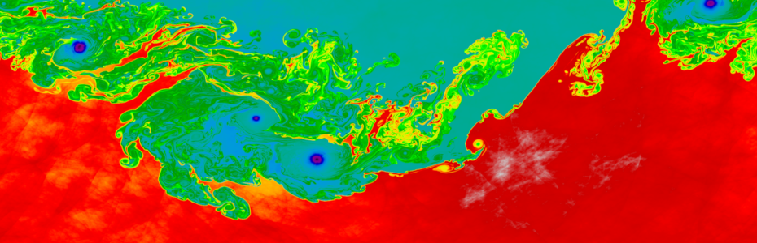
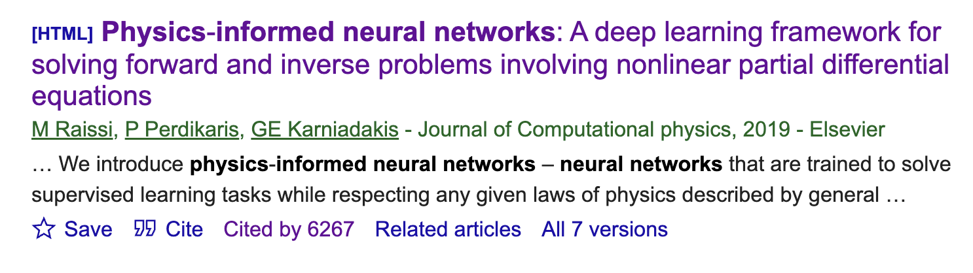
Outline
Data-driven neural network approach to solving differential equations (DEs)
Physics-informed neural network approach for DEs
Applications and limitations
Coding exercise

Slide 3
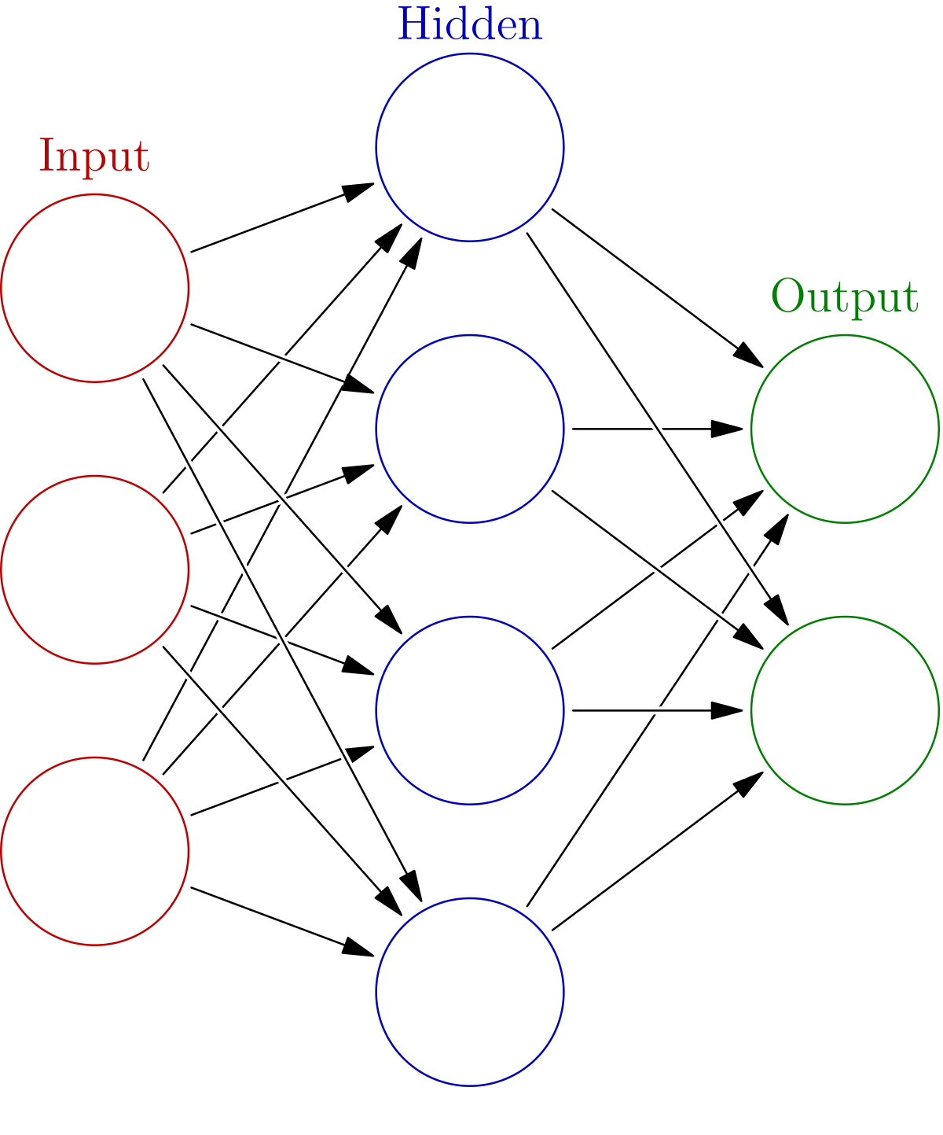
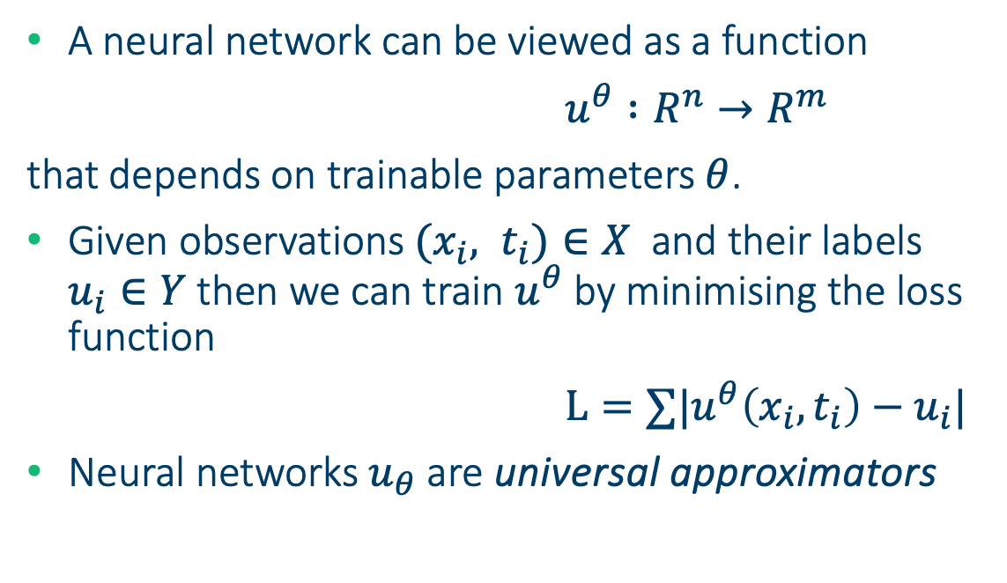
Neural networks recap
$E.g.: u^{θ} :R^{3}→R^{2}$
A neural network can be viewed as a function
$u^{θ} :R^{n}→R^{m}$
that depends on trainable parameters $θ$.
Given observations ${(x}_{i}, t_{i})∈X$ and their labels $u_{i}∈Y$then we can train $u^{θ}$by minimising the loss function
$L=∑|u^{θ}\left(x_{i}, t_{i}\right)−u_{i}|$
Neural networks $u_{θ}$ are universal approximators

Slide 4
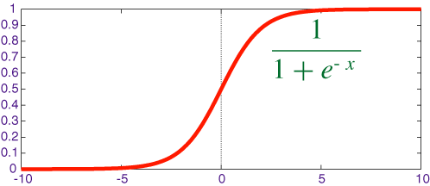
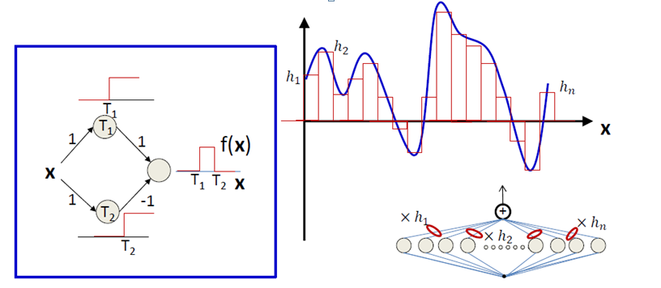

Neural networks recap
Sigmoid activation $σ(x)$
Single layer: $f_{i}\left(x\right)=σ\left(W_{i}x+b_{i}\right)$
Multiple layers: ${y= f}_{n}∘…∘f_{1}\left(x\right)$
Universality:

Slide 5
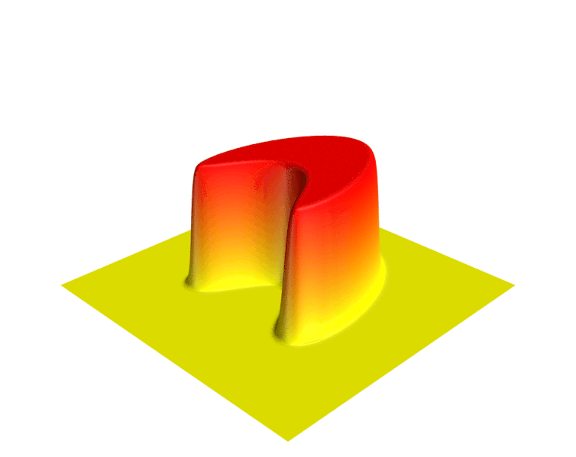
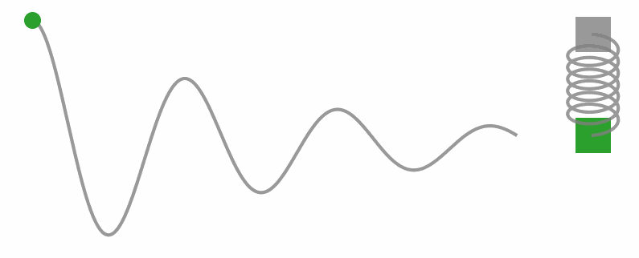
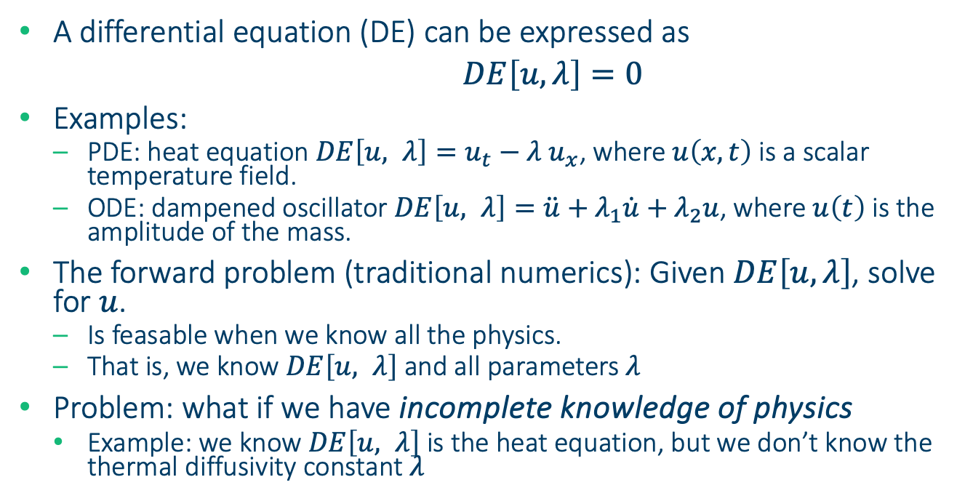
Solving differential equations
Heat equation
A differential equation (DE) can be expressed as
$DE\left[u, λ\right]=0$
Examples:
PDE: heat equation $DE\left[u, λ\right]=u_{t}−{λ u}_{x}$, where $u\left(x, t\right)$ is a scalar temperature field.
ODE: dampened oscillator $DE\left[u, λ\right]=\ddot{u}+λ_{1}\dot{u}+λ_{2}u$, where $u\left(t\right)$ is the amplitude of the mass.
The forward problem (traditional numerics): Given $DE\left[u, λ\right]$, solve for $u$.
Is feasable when we know all the physics.
That is, we know $DE\left[u, λ\right]$ and all parameters $λ$
Problem: what if we have incomplete knowledge of physics
Example: we know $DE\left[u, λ\right]$ is the heat equation, but we don’t know the thermal diffusivity constant $λ$
Dampened oscillator

Slide 6
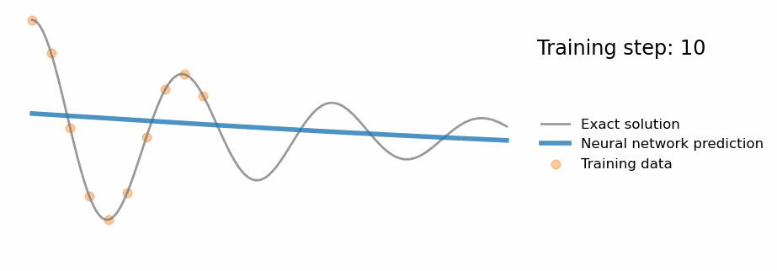
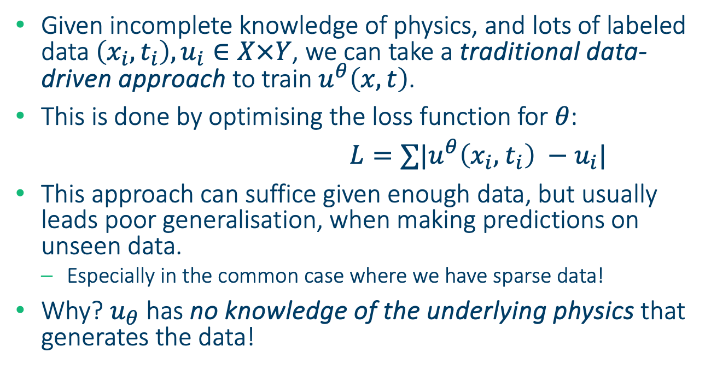
Potential solution: data-driven approach
Given incomplete knowledge of physics, and lots of labeled data $\left(x_{i},t_{i}\right), u_{i}∈X×Y$, we can take a traditional data-driven approach to train $u^{θ}\left(x, t\right)$.
This is done by optimising the loss function for $θ$:
$L=∑|u^{θ}\left(x_{i}, { t}_{i}\right) −u_{i}|$
This approach can suffice given enough data, but usually leads poor generalisation, when making predictions on unseen data.
Especially in the common case where we have sparse data!
Why? $u_{θ}$ has no knowledge of the underlying physics that generates the data!

Slide 7
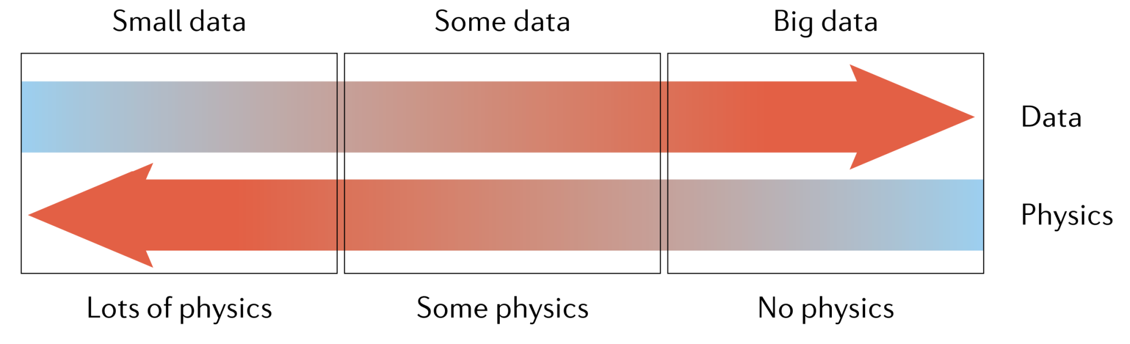
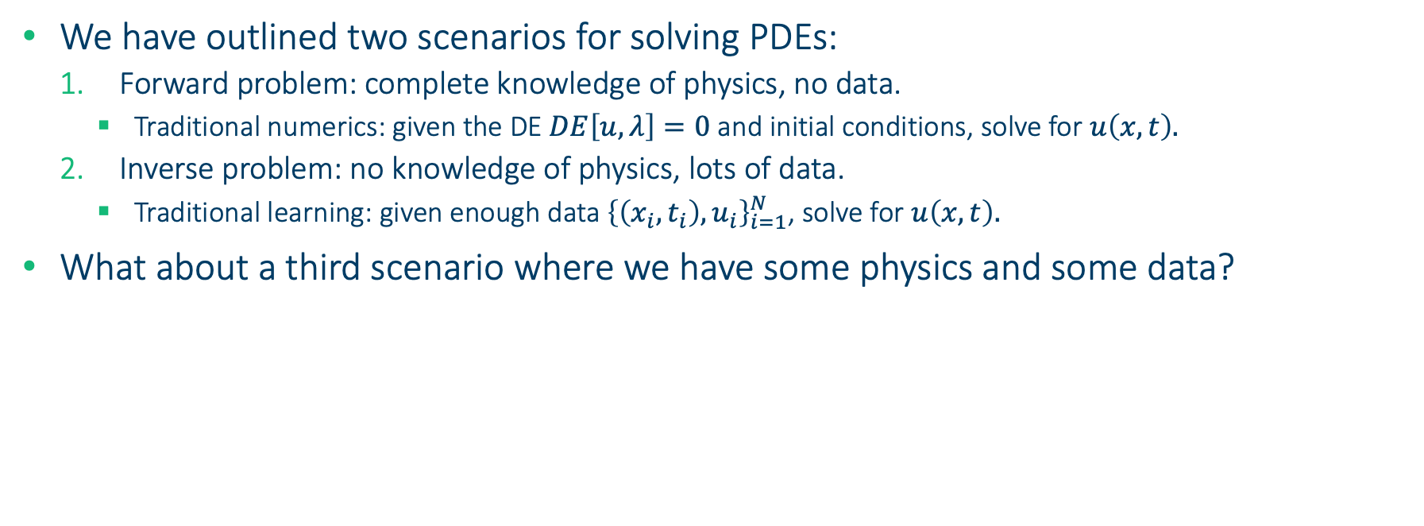
Some physics and some data
We have outlined two scenarios for solving PDEs:
Forward problem: complete knowledge of physics, no data.
Traditional numerics: given the DE $DE\left[u, λ\right]=0$ and initial conditions, solve for $u\left(x, t\right).$
Inverse problem: no knowledge of physics, lots of data.
Traditional learning: given enough data ${\left\{\left(x_{i},t_{i}\right), u_{i}\right\}}_{i=1}^{N}$, solve for $u\left(x, t\right).$
What about a third scenario where we have some physics and some data?
Scenario 1
???
Scenario 2

Slide 8
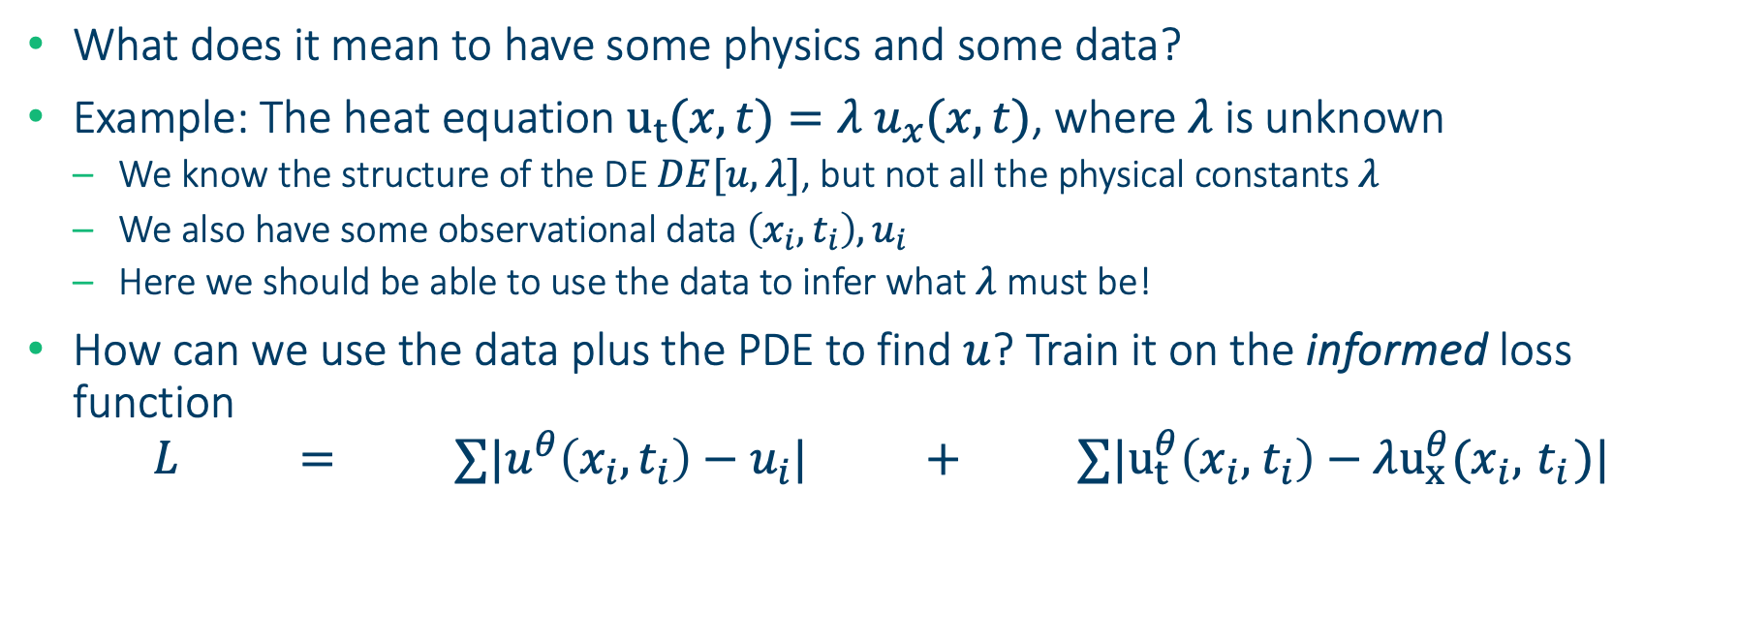
Physics informed neural networks (PINNs)
What does it mean to have some physics and some data?
Example: The heat equation $u_{t}(x, t)={λ u}_{x}(x, t)$, where $λ$ is unknown
We know the structure of the DE $DE[u, λ]$, but not all the physical constants $λ$
We also have some observational data $\left(x_{i},t_{i}\right), u_{i}$
Here we should be able to use the data to infer what $λ$ must be!
How can we use the data plus the PDE to find $u$? Train it on the informed loss function
$${L = ∑|u}^{θ}\left(x_{i}, t_{i}\right)−u_{i}| + ∑|u_{t}^{θ}\left(x_{i}, { t}_{i}\right)−λu_{x}^{θ}(x_{i}, { t}_{i})|$$
PINN Loss
=
Traditional, data-driven loss
+
Additional physics loss

Slide 9
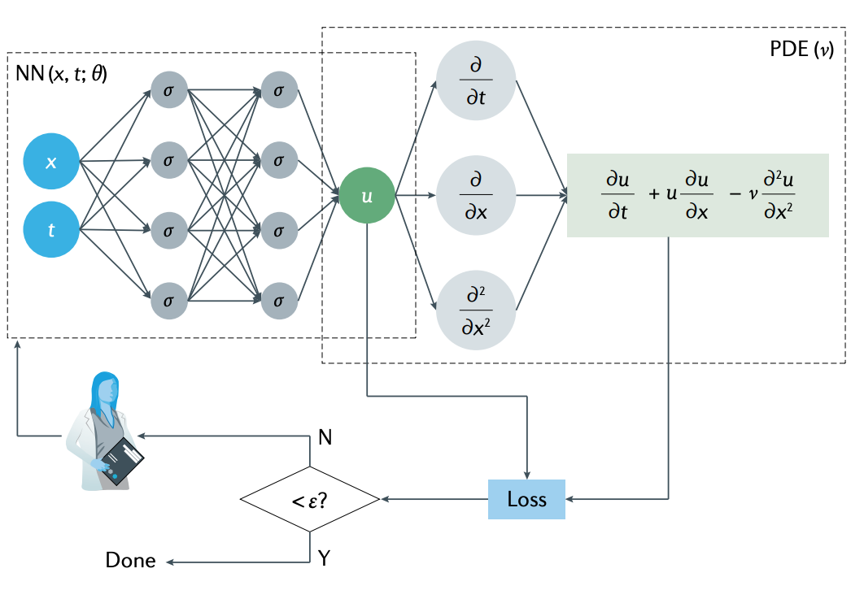
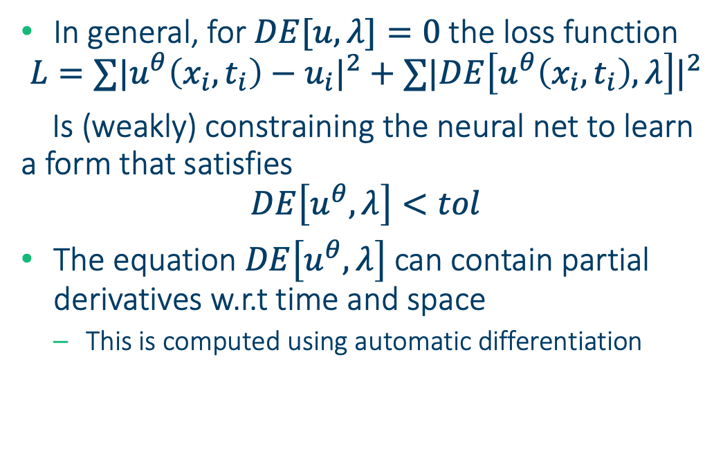
Physics informed neural networks (PINNs)
In general, for $DE[u, λ]=0$the loss function
$${L=∑|u}^{θ}\left(x_{i}, t_{i}\right)−u_{i}|^{2}+∑|DE\left[u^{θ}\left(x_{i}, t_{i}\right), λ\right]|^{2}$$
Is (weakly) constraining the neural net to learn a form that satisfies
$$DE\left[u^{θ}, λ\right]<tol$$
The equation $DE\left[u^{θ}, λ\right]$ can contain partial derivatives w.r.t time and space
This is computed using automatic differentiation

Slide 10
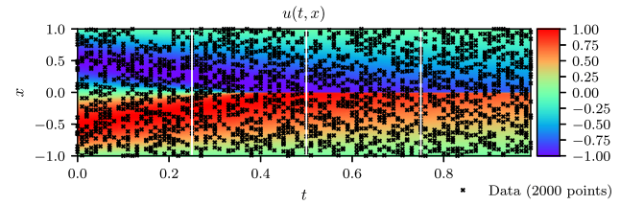
Advantages of PINNs
Data Efficiency
Interpretable Models
Incomplete models and imperfect data
Strong generalization in small data regime
Tackling high dimensionality
Difficult geometries where meshing is not feasible
Notes:
Data Efficiency: "By incorporating known physical laws, PINNs often require fewer data points for accurate predictions."
Interpretable Models: "PINNs offer a more interpretable framework, as they integrate physical equations, making the model's behavior easier to understand."
Incomplete Models and Imperfect Data: "PINNs are robust to gaps in data and model imperfections, as they can leverage physical laws to fill in the blanks."
Strong Generalization in Small Data Regime: "PINNs excel in scenarios with limited data, as the embedded physics act as a strong regularizer, enhancing generalization."
Tackling High Dimensionality: "PINNs are adept at handling high-dimensional problems, breaking the curse of dimensionality by leveraging the structure of physical laws.”
Difficult Geometries Where Meshing is Not Feasible: "PINNs are mesh-free, making them ideal for problems involving complex or moving geometries where traditional meshing is impractical."

Slide 11
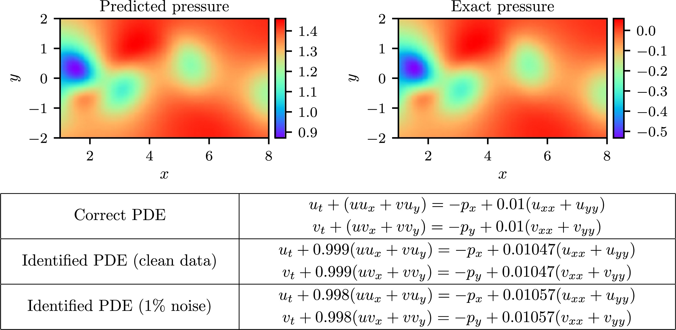
Applications – 2D Navier-Stokes toy problem

Slide 12
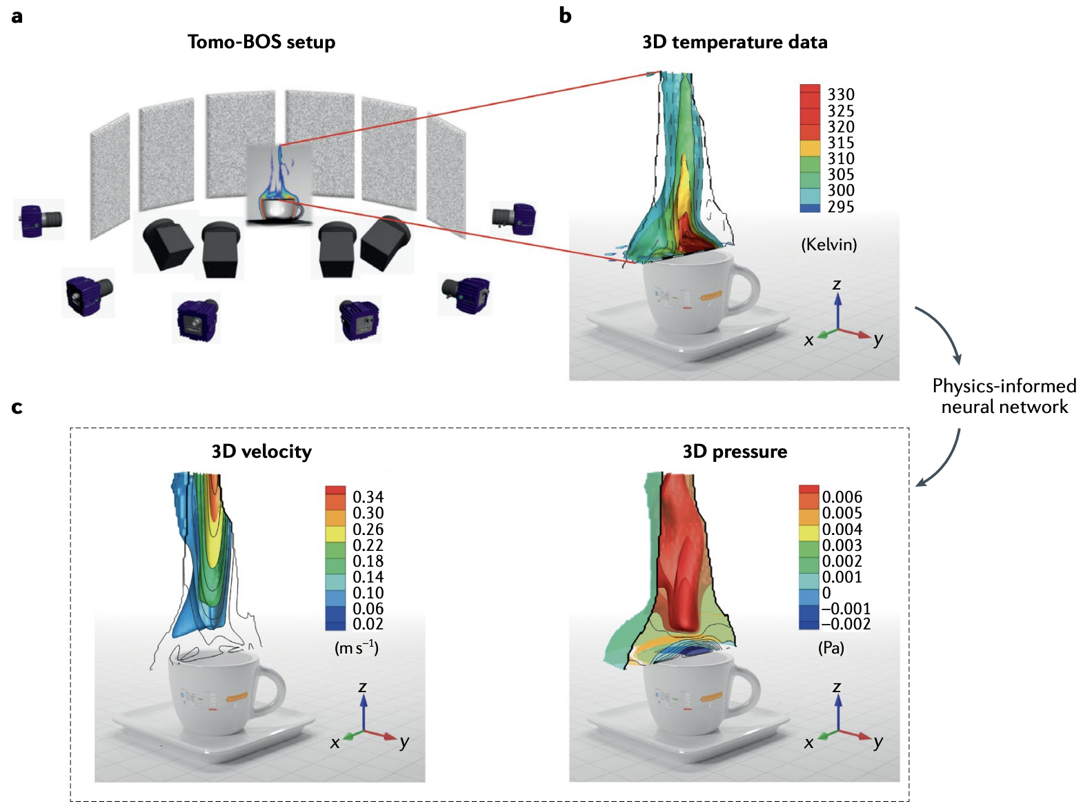
Applications – Flow over coffee cup
Notes:
inferring the 3D flow over an espresso cup based using the Tomo-BOs imaging system and physics-informed neural networks (PiNNs).
a | Six cameras are aligned around an espresso cup, recording the distortion of the dot-patterns in the panels placed in the background, where the distortion is caused by the density variation of the airflow above the espresso cup. The image data are acquired and processed with LaVision’s Tomographic BOS software (DaVis 10.1.1).
b | 3D temperature field derived from the refractive index field and reconstructed based on the 2D images from all six cameras.
c | Physics-informed neural network (PINN) inference of the 3D velocity field (left) and pressure field (right) from the temperature data.
The Tomo-BOS experiment was performed by F. Fuest, Y. J. Jeon and C. Gray from LaVision. The PINN inference and visualization were performed by S. Cai and C. Li at Brown University. Image courtesy of S. Cai and C. Li, Brown University

Slide 13
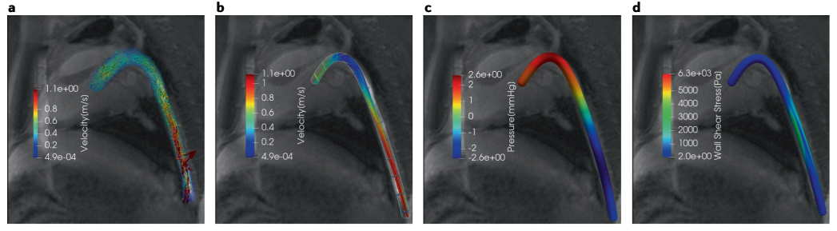
Applications – Flow through aorta
Notes:
Physics-informed filtering of in-vivo 4D-flow magnetic resonance imaging data of blood flow in a porcine descending aorta. Physics-informed neural network (PINN) models can be used to de-noise and reconstruct clinical magnetic resonance imaging (MRI) data of blood velocity, while constraining this reconstruction to respect the underlying physical laws of momentum and mass conservation, as described by the incompressible Navier–Stokes equations.
Moreover, a trained PINN model has the potential to aid the automatic segmentation of the arterial wall geometry and to infer important biomarkers such as blood pressure and wall shear stresses.
a | Snapshot of in-vivo 4D-flow MRI measurements. b–d | A PINN reconstruction of the velocity field (panel b), pressure (panel c), arterial wall surface geometry and wall shear stresses (panel d).
The 4D-flow MRI data were acquired by E. Hwuang and W. Witschey at the University of Pennsylvania. The PINN inference and visualization were performed by S. Wang, G. Kissas and P. Perdikaris at the University of Pennsylvania.

Slide 14

Software
DeepXDE – Python - github.com/lululxvi/deepxde
Implementation from original authors
Supports: TensorFlow, JAX, PyTorch
DeepONets, MFNNs, PINNs
Others:
PyDEns – Python, TensorFlow
NeuroDiffEq – Python, PyTorch
NeuralPDE - Julia

Slide 15
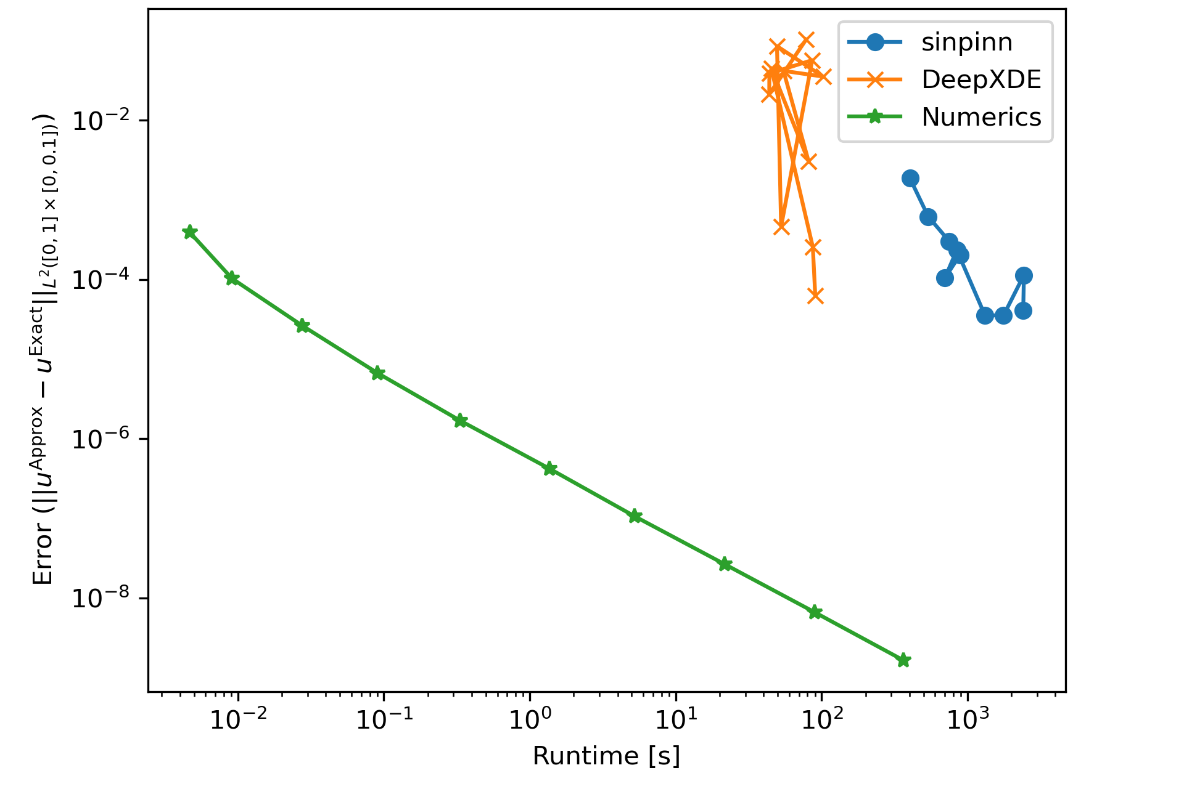
Challenges and limitations
Comparison DeepXDE vs PyTorch vs Crank—Nicolson for 1D heat equation
Computational complexity
Requirement for physical laws
“Weakly” enforces physical constraints.
Multiscale and multi-physics problems
Non-robust training and convergence

Slide 16
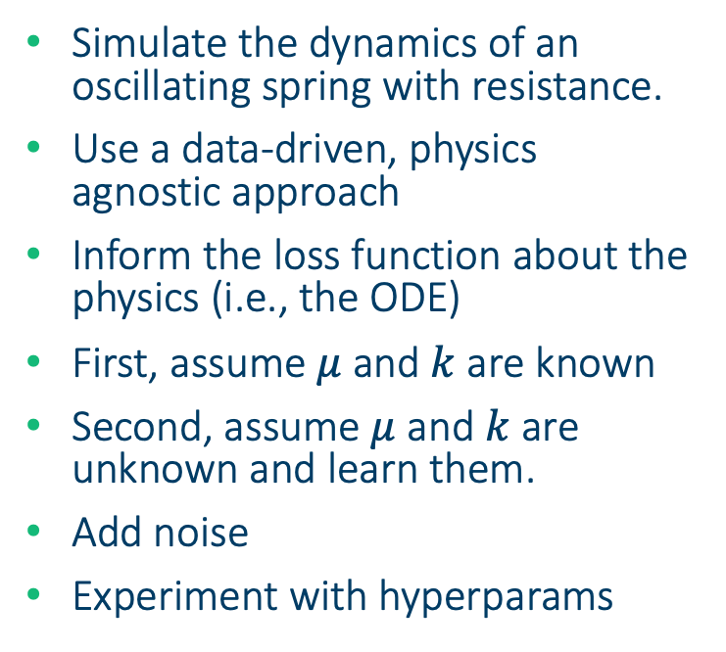
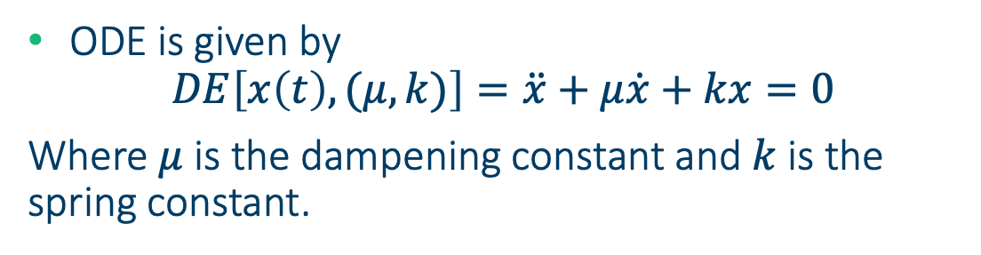
Coding a PINN from scratch
github.com/bentaps/PINN-example
Simulate the dynamics of an oscillating spring with resistance.
Use a data-driven, physics agnostic approach
Inform the loss function about the physics (i.e., the ODE)
First, assume $μ$ and $k$ are known
Second, assume $μ$ and $k$ are unknown and learn them.
Add noise
Experiment with hyperparams
ODE is given by
$$DE\left[x\left(t\right), (μ, k)\right]=\ddot{x}+μ\dot{x}+kx=0$$
Where $μ$ is the dampening constant and $k$ is the spring constant.

Slide 17
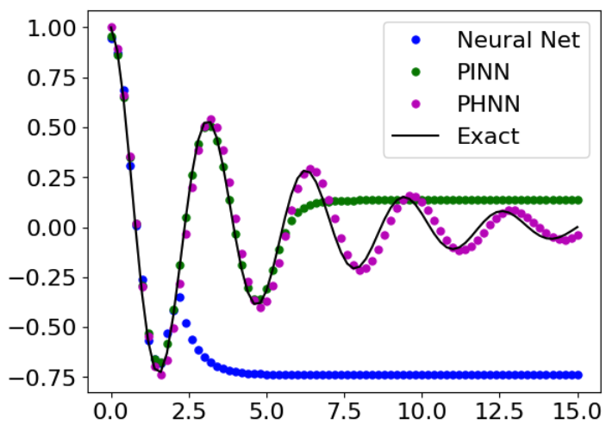
Pseudo-Hamiltonian Neural Nets
An alternative to PINNs
Symmetries and laws are enforced intrisically through network architechture
Exact preservation of physics (as opposed to “weak”)
More data efficient
Does not require user-defined collocation points
Simpler loss function
More efficient back prop.

